Slide 1




Ai in cybersecurity
Mohsen Heidari
Systems manager
07/08/2025
Blog: aisecgen.com

Slide 2
Agenda
Evolution of Cybersecurity Tools
Traditional vs. Modern Threat Defenses
Tools in Action: NGFW, EDR/XDR
AI & GenAI in Cybersecurity (Defense & Offence)
Top Cyber Attacks
AI against AI
Cyber security Innovation 2025

Slide 3
Cybersecurity Maturity
Traditional AV & legacy firewalls – basic threat blocking
IPS, SIEM & log analysis – improved insight, still manual
EDR → XDR → AI-powered defence – automated, intelligent protection
Agentic AI systems – autonomous decision-making & real-time adaptability

Slide 4
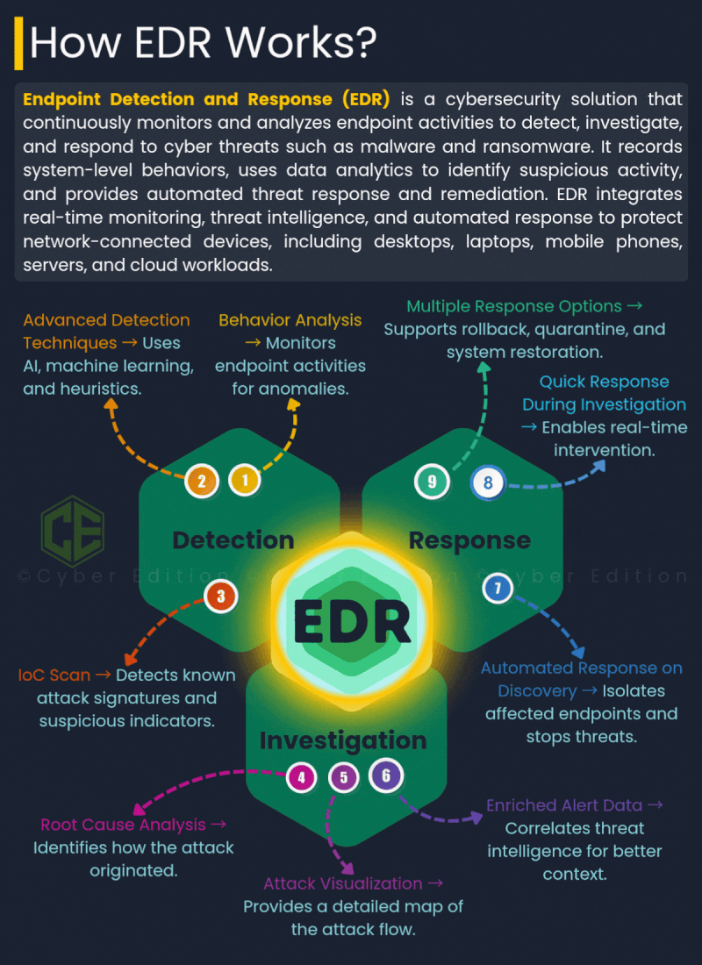
Detection 1️⃣Behavior Analysis – Spot anomalies in real-time 2️⃣ Advanced Techniques – AI, ML, and heuristics at play 3️⃣ IoC Scans – Uncover known attack signatures
Investigation 4️⃣ Root Cause Analysis–Trace back to where it all began 5️⃣ Attack Visualization – Map the entire attack flow 6️⃣ Enriched Alerts – Smarter insights with threat intelligence
Response 7️⃣ Automated Actions – Instantly isolate threats 8️⃣ Real-Time Response – Intervene fast, mitigate faster 9️⃣ Multiple Options – Quarantine, rollback, and recover

Slide 5

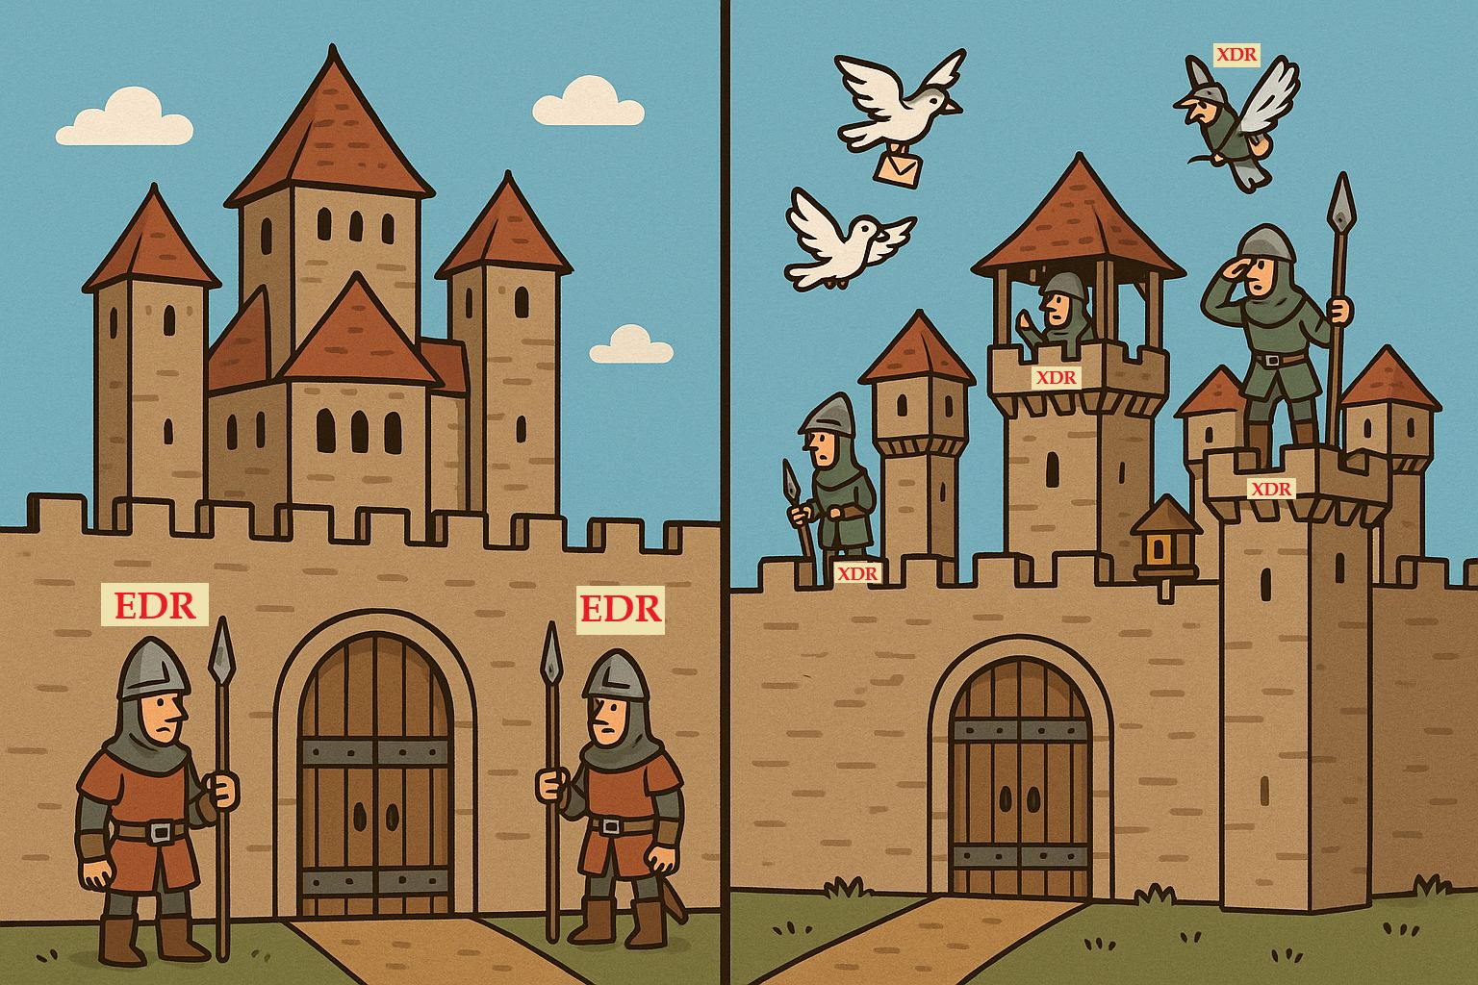
EDR vs XDR
What's the Difference?
EDR: Endpoint-focused detection and response
XDR: Unified detection across endpoints, email, cloud, etc.
XDR offers broader visibility and correlation

Slide 6
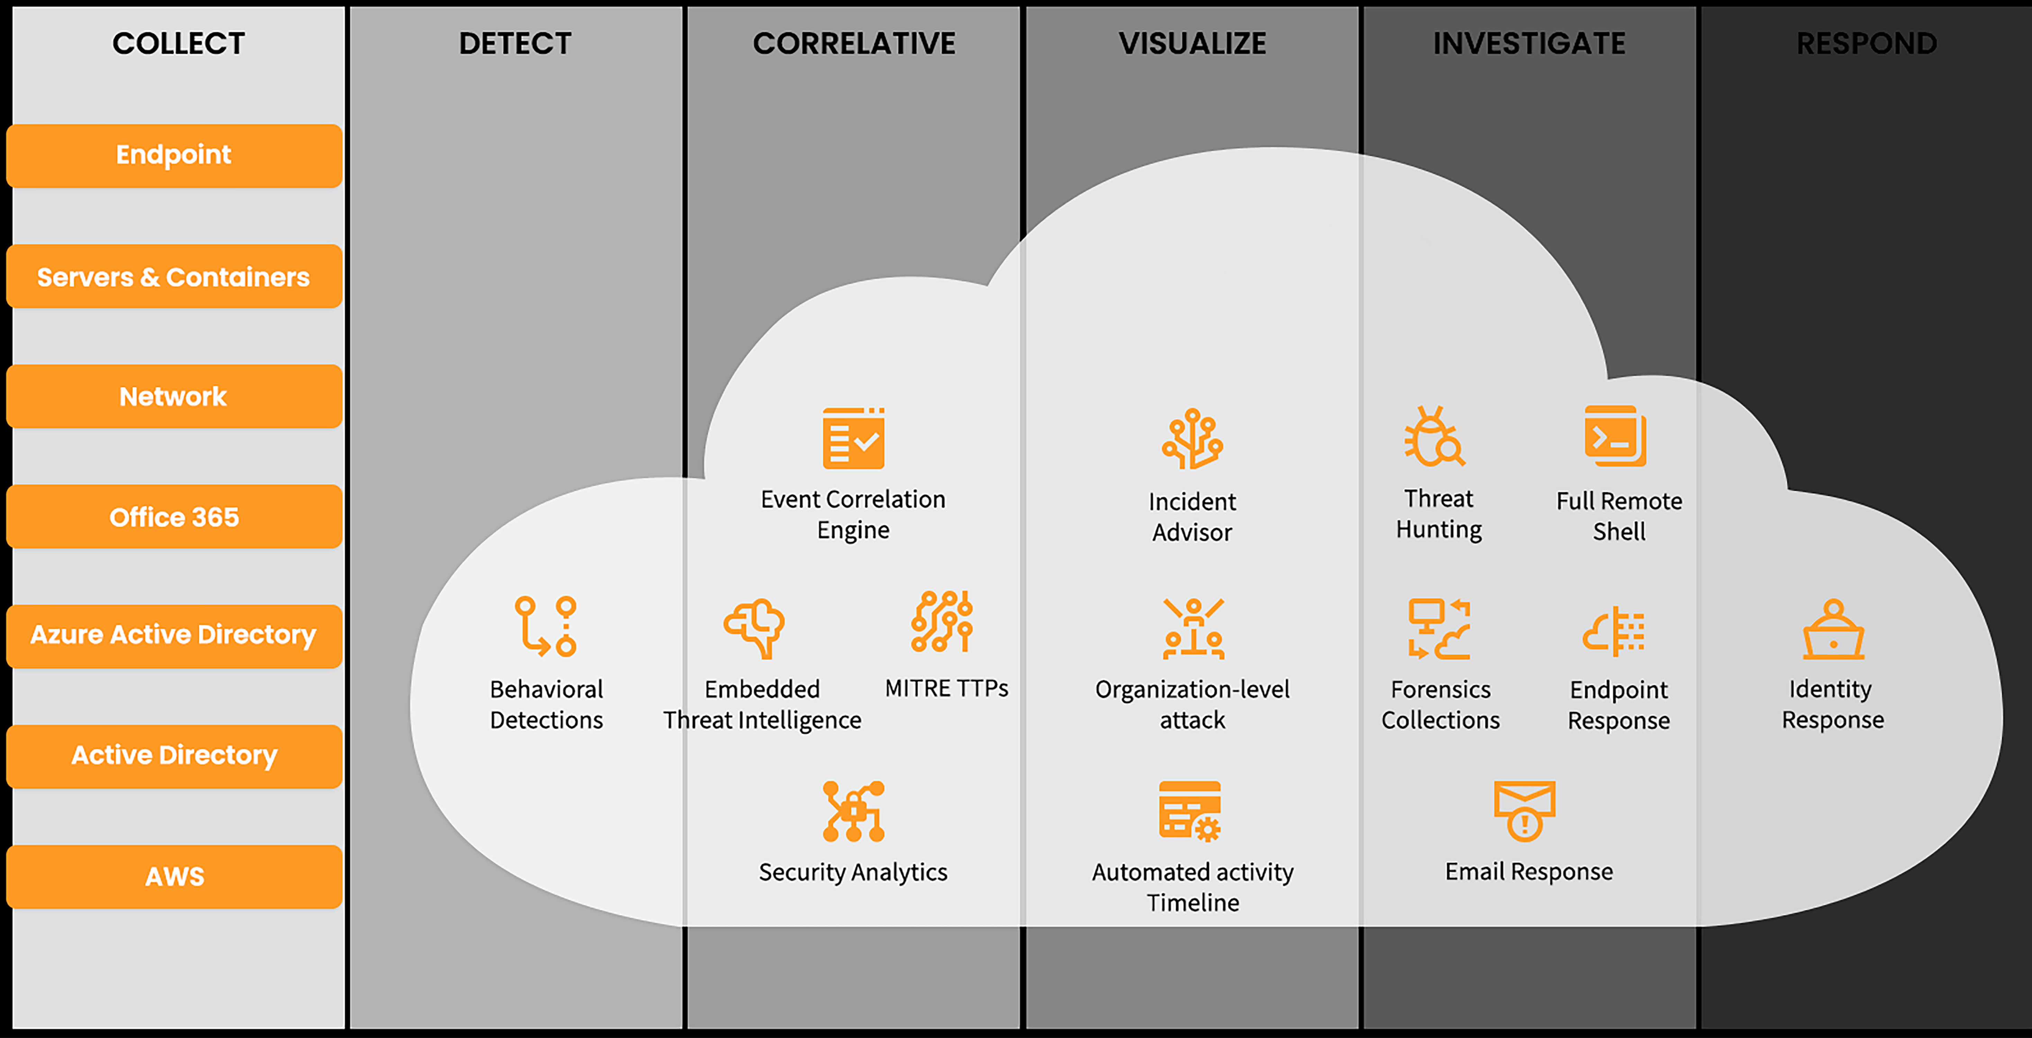
GravityZone Cloud

Slide 7
Cyber attacks
Data abuse
Top techniques
Ai assisted attacks

Slide 8

How Hackers are abusing Ai for Cyber-attacks
Social Engineering schemes
Password Hacking
Deepfakes
Data poisoning

Slide 9
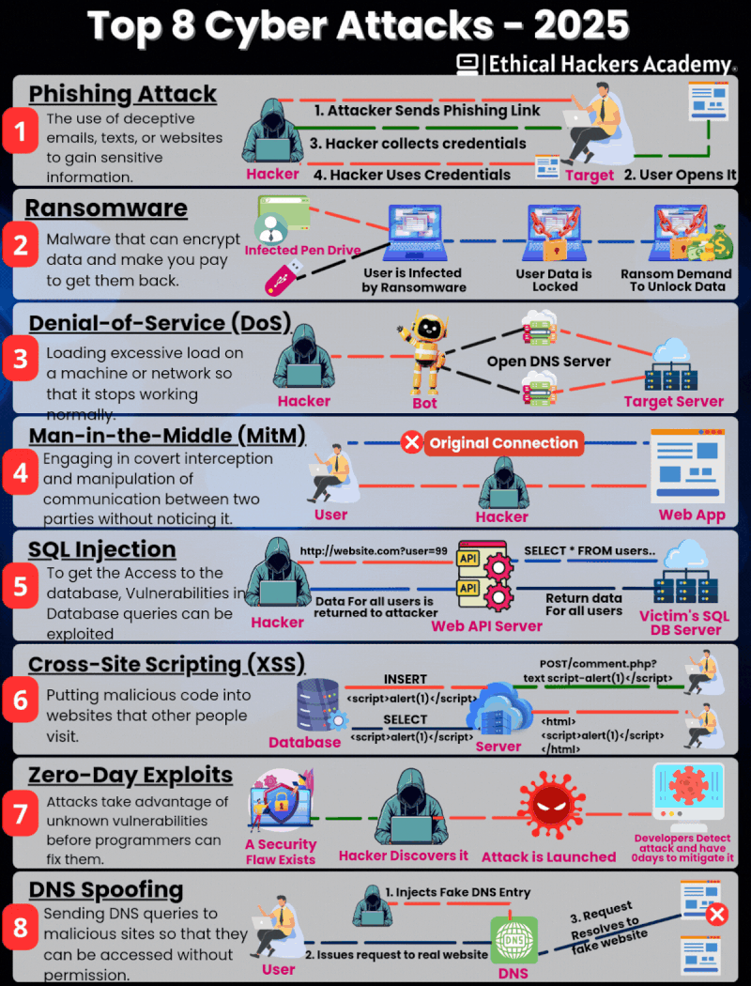
Attack Type | Pre‑AI Growth Rate | AI Era (2022–2025) | Impact Summary
Phishing | ~5–10% growth annually | ~40–60% increase per year; credential phishing rose ~700% in late‑2024 (controld.com) | 10× volume increase; much higher success rates
Ransomware | ~15–20% annual rise | 49% climb in H1 2025; AI accelerates execution speed (SC Media, The Guardian, IBM Newsroom) | Faster deployment and higher breach frequency
DoS / DDoS | ~10% per year | Surge via DNS amplification: +4,400% in 2024; ~26% of all DDoS (SC Media, IBM Newsroom) | Amplified volume via AI-controlled botnets
MITM (Man-in-the-Middle) | ~5–10% per year | ~19% of breaches involve sophisticated MITM; AI aids session hijacks (IBM Newsroom, SC Media) | AI-enhanced tools bypass MFA or replays
Zero‑Day Exploits | ~5–7% annual increase | ~27% year-on-year rise in 2025 (SC Media, researchgate.net) | Attackers can generate or discover exploits via AI
SQLi, XSS | Slow steady rise (mid‑% range) | Still common but overshadowed by AI vectors (sciencedirect.com, researchgate.net) | Traditional web attacks less dominant but persistent
DNS Spoofing / Quishing | <2% of phishing domains | DNS abuse doubled; domains live ~11.5 days; rising vector via QR and AI campaigns (arxiv.org, dmarcreport.com) | Increasingly used in large-scale spear‑phish campaigns

Slide 10







Top AI-Related Security Incidents
1| Data leak and oversharing
3| Non - Compliance
Uncertainty and liability on non-compliant AI adoption due to emerging AI.
User may leak sensitive data to shadow AI apps or access sensitive data via AI apps.
2| Vulnerabilities and emerging threats
Threats actor my exploit Vulnerabilities in AI apps to access valuable resources.

Slide 11
AI vs Ai
AI-assisted attacks are faster and more advanced
Traditional response is no longer enough
Inteligence defence tools like XDR, EDR, and GenAI are essential
Organisations must prepare, automate, and train

Slide 12
AI-Driven Innovation in 2025
Real-time retrainable firewalls (ARX)
Agentic AI in SOCs (ReliaQuest)
Unified cloud security (CNAPP evolution)
Shadow AI & prompt injection controls

Slide 13


THANK YOU
www.linkedin.com/in/heidarimohsen
heidari.mohsen@outlook.com
www.aisecgen.com

